Slide 1
HIV forecasting
By: Kelvin Ortiz

Slide 2


Mission
Increase HIV awareness and prevention
Predict HIV infections (5 years)
Find countries with high rate of infection for future years

Slide 3
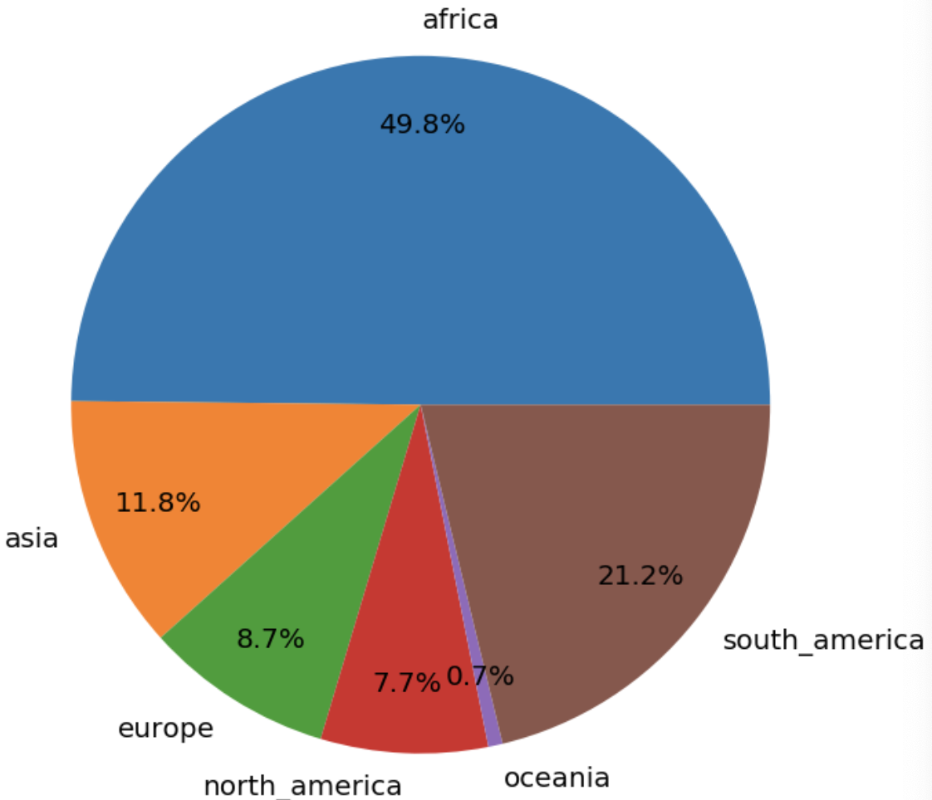
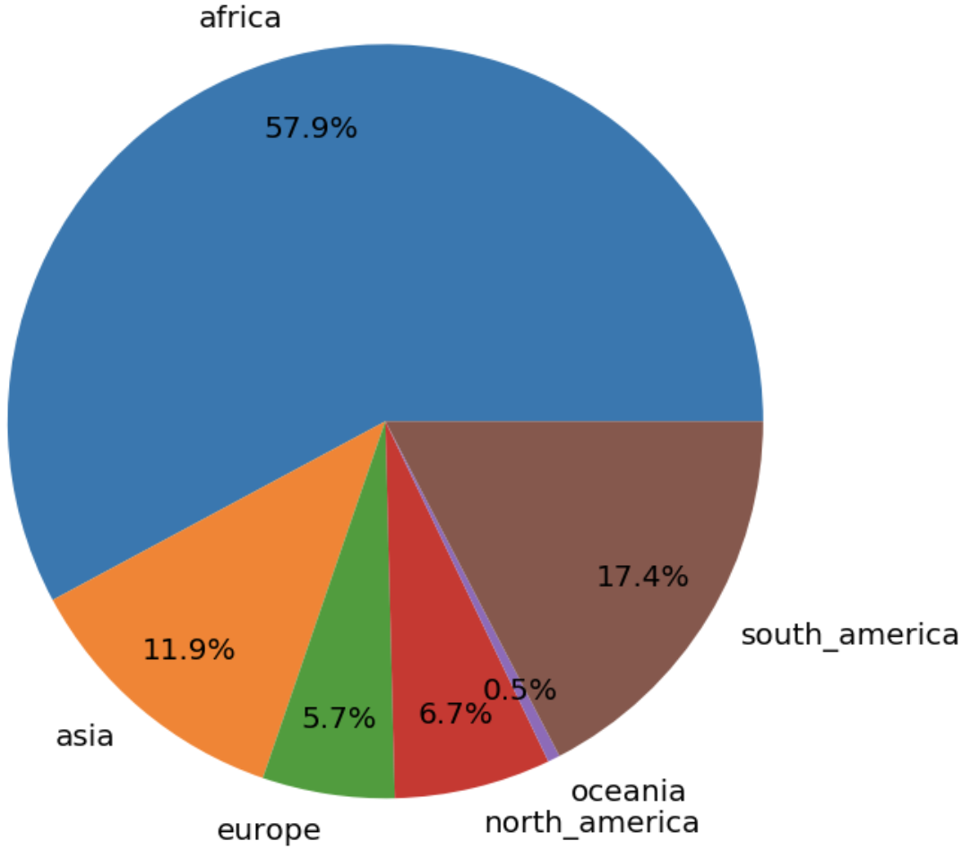
New Infections by Continent
2009-2014
2014-2019

Slide 4
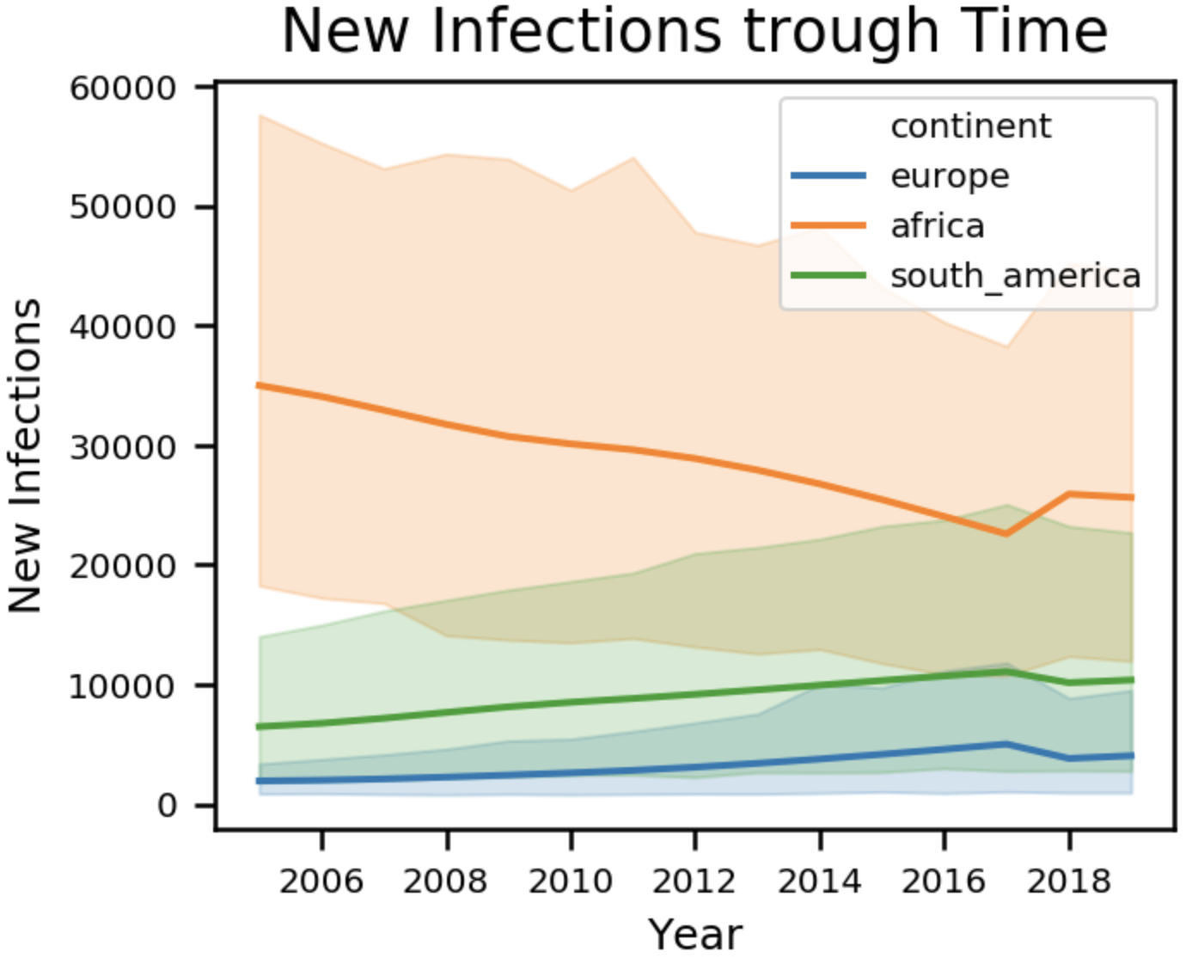
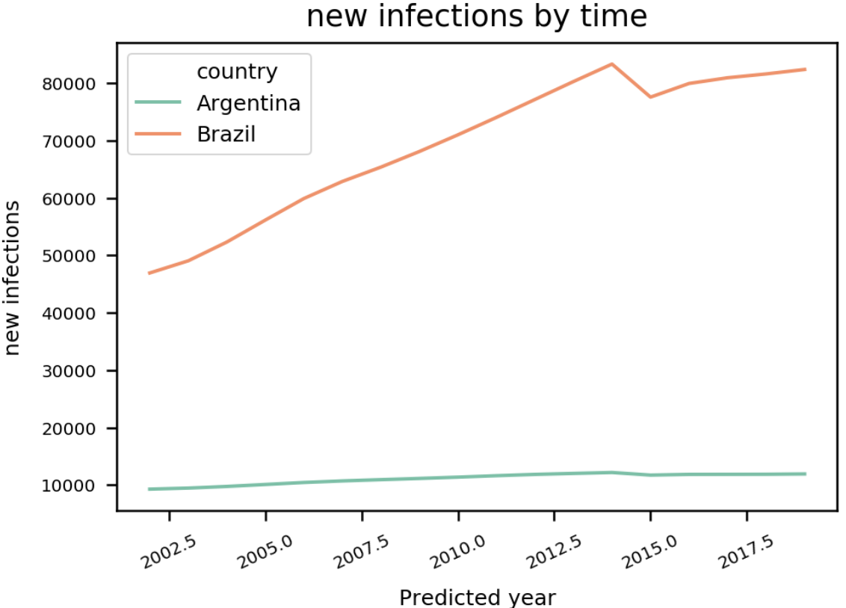
New Infections by Year
I

Slide 5
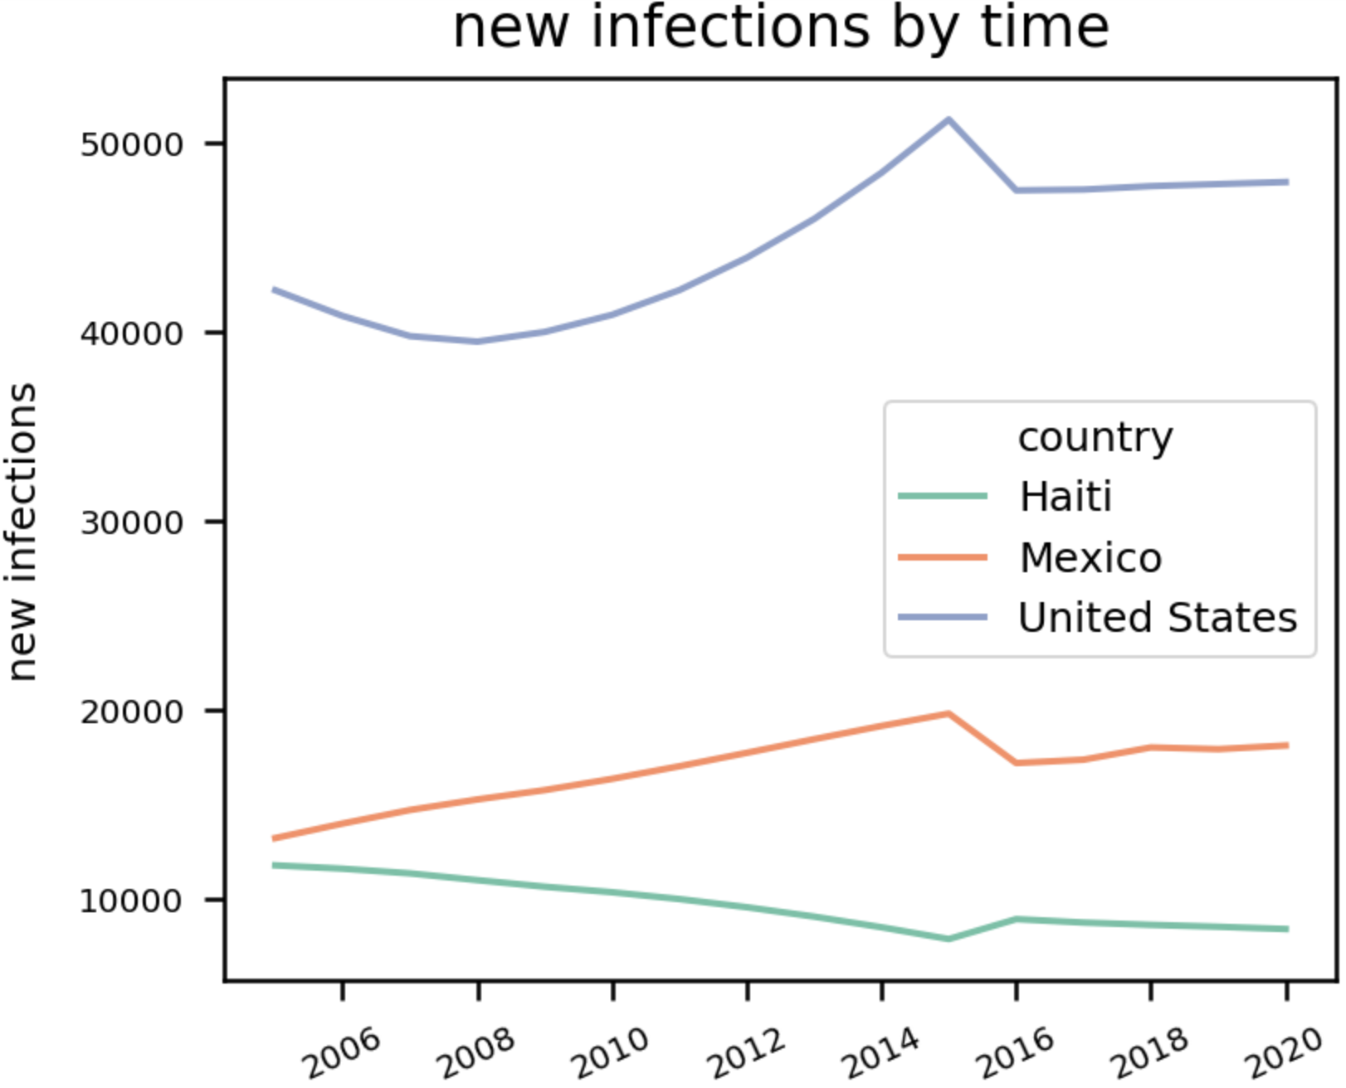
Where is the focus? (1)
North
America
14k
18k

Slide 6
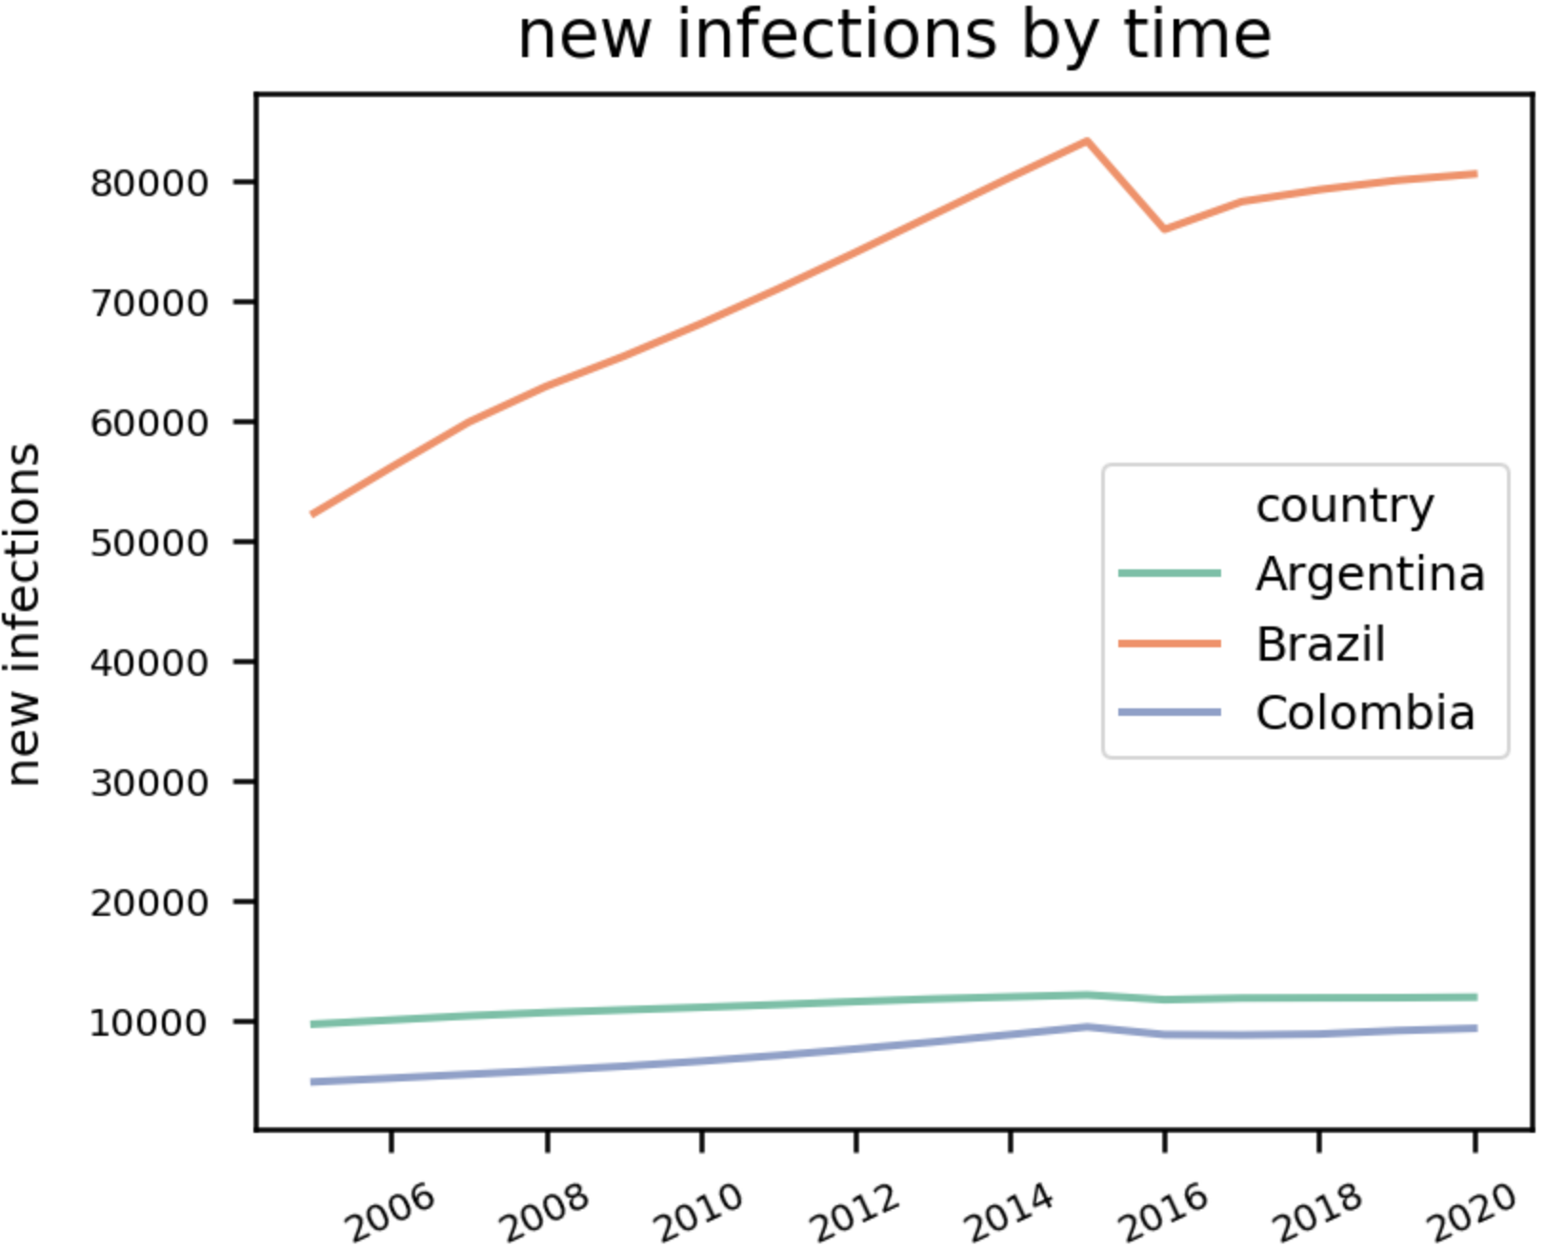
~80k
~75k
Where is the focus? (2)
South
America

Slide 7
Task
Target
Predict New Infections for 5 years
Brazil and Mexico
New Infections (shifted by 5 years)
Variables
16 Features initially

Slide 8
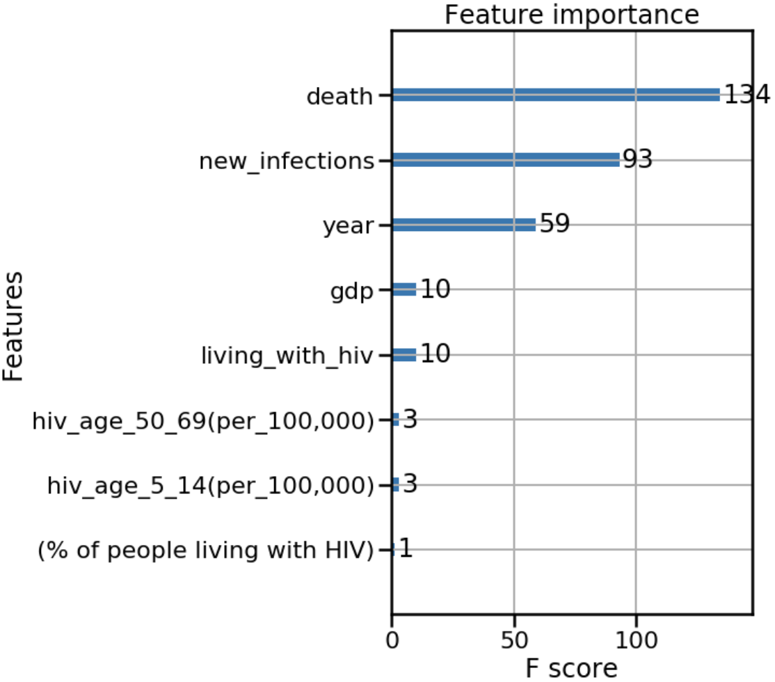
Feature Selection
Tree-based Feature selection based on F-Score metric Ranking

Slide 9
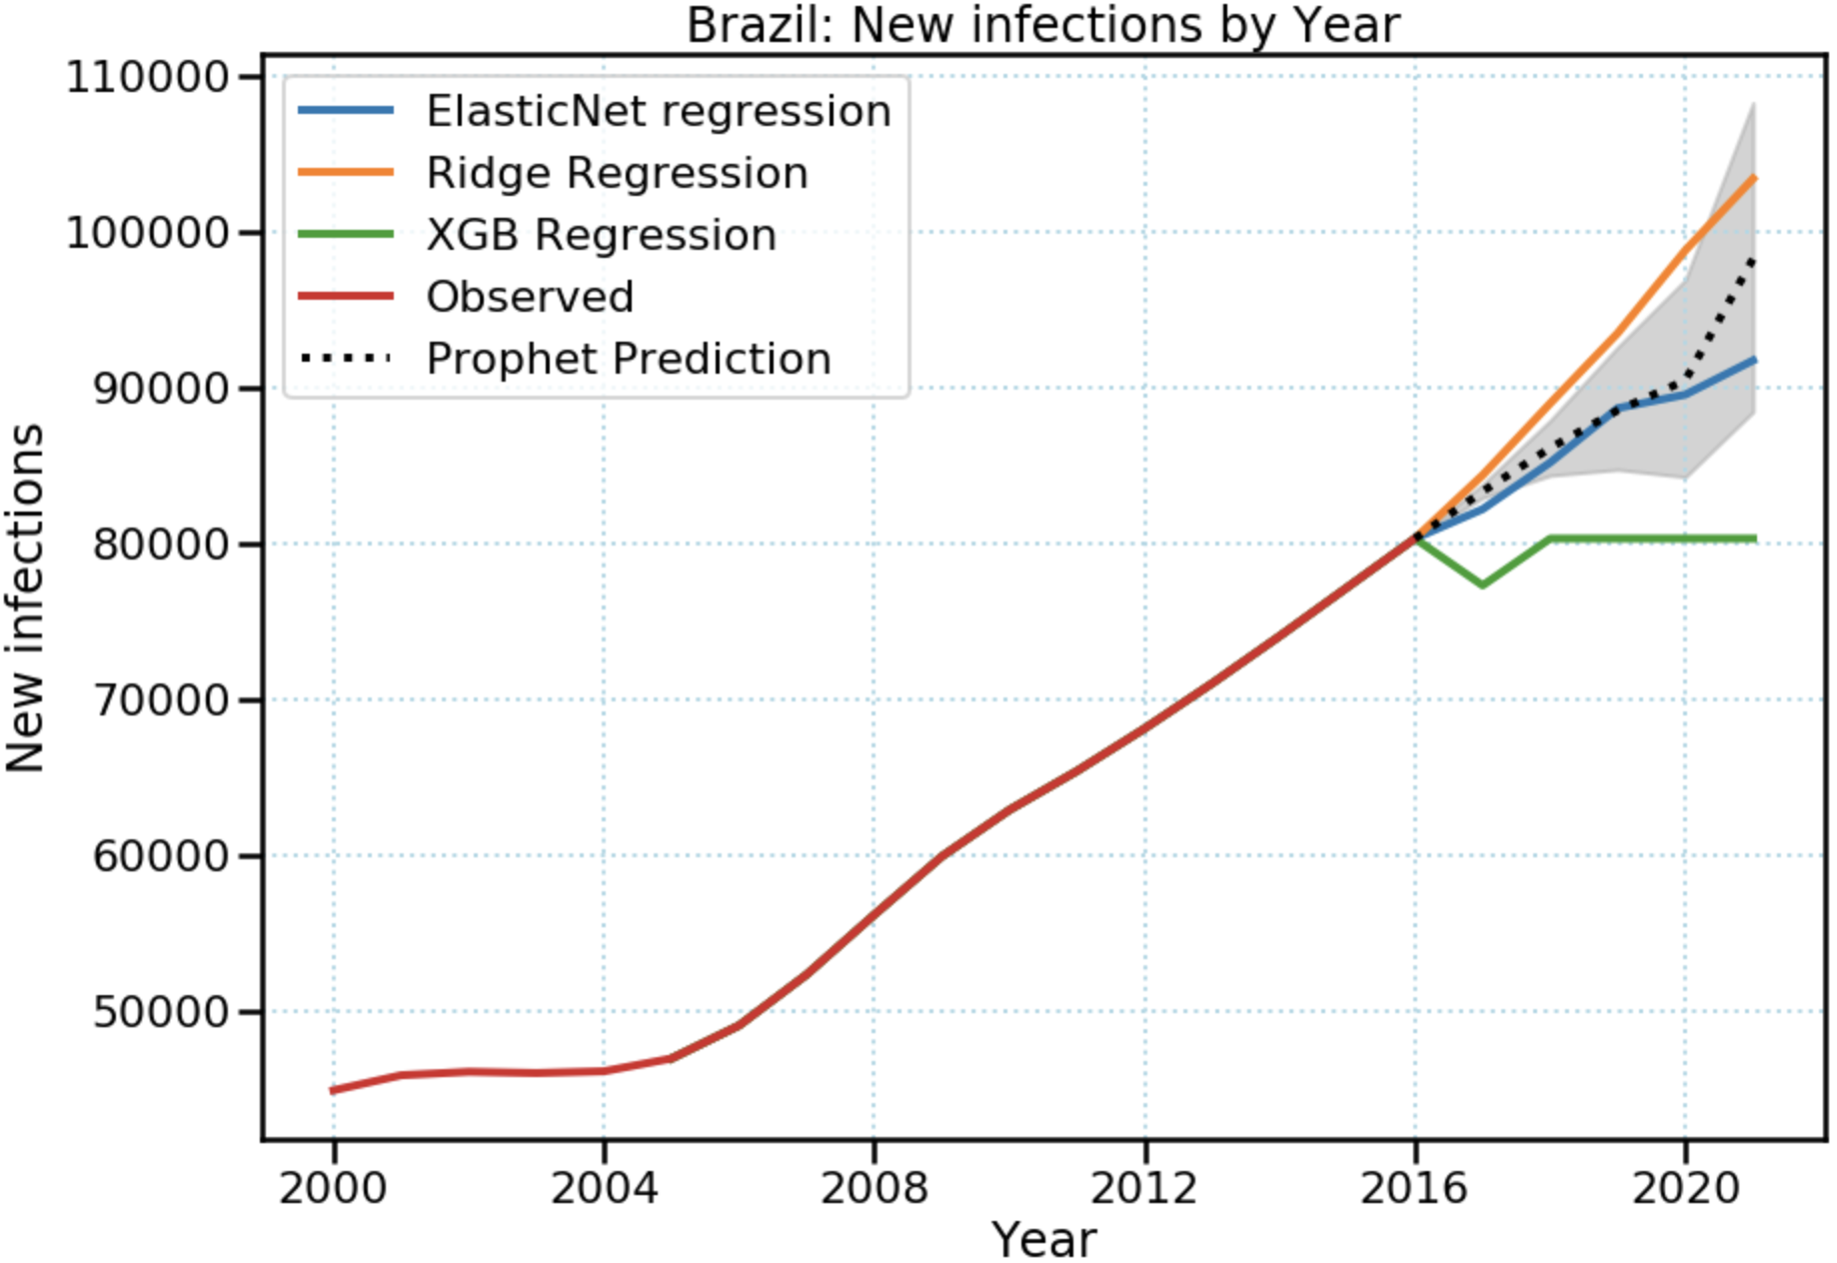
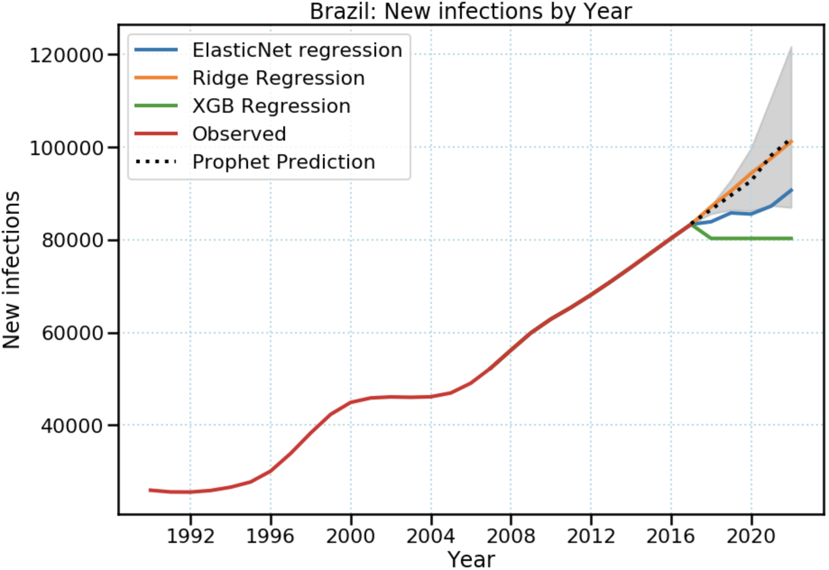
~100k
~90k

Slide 10
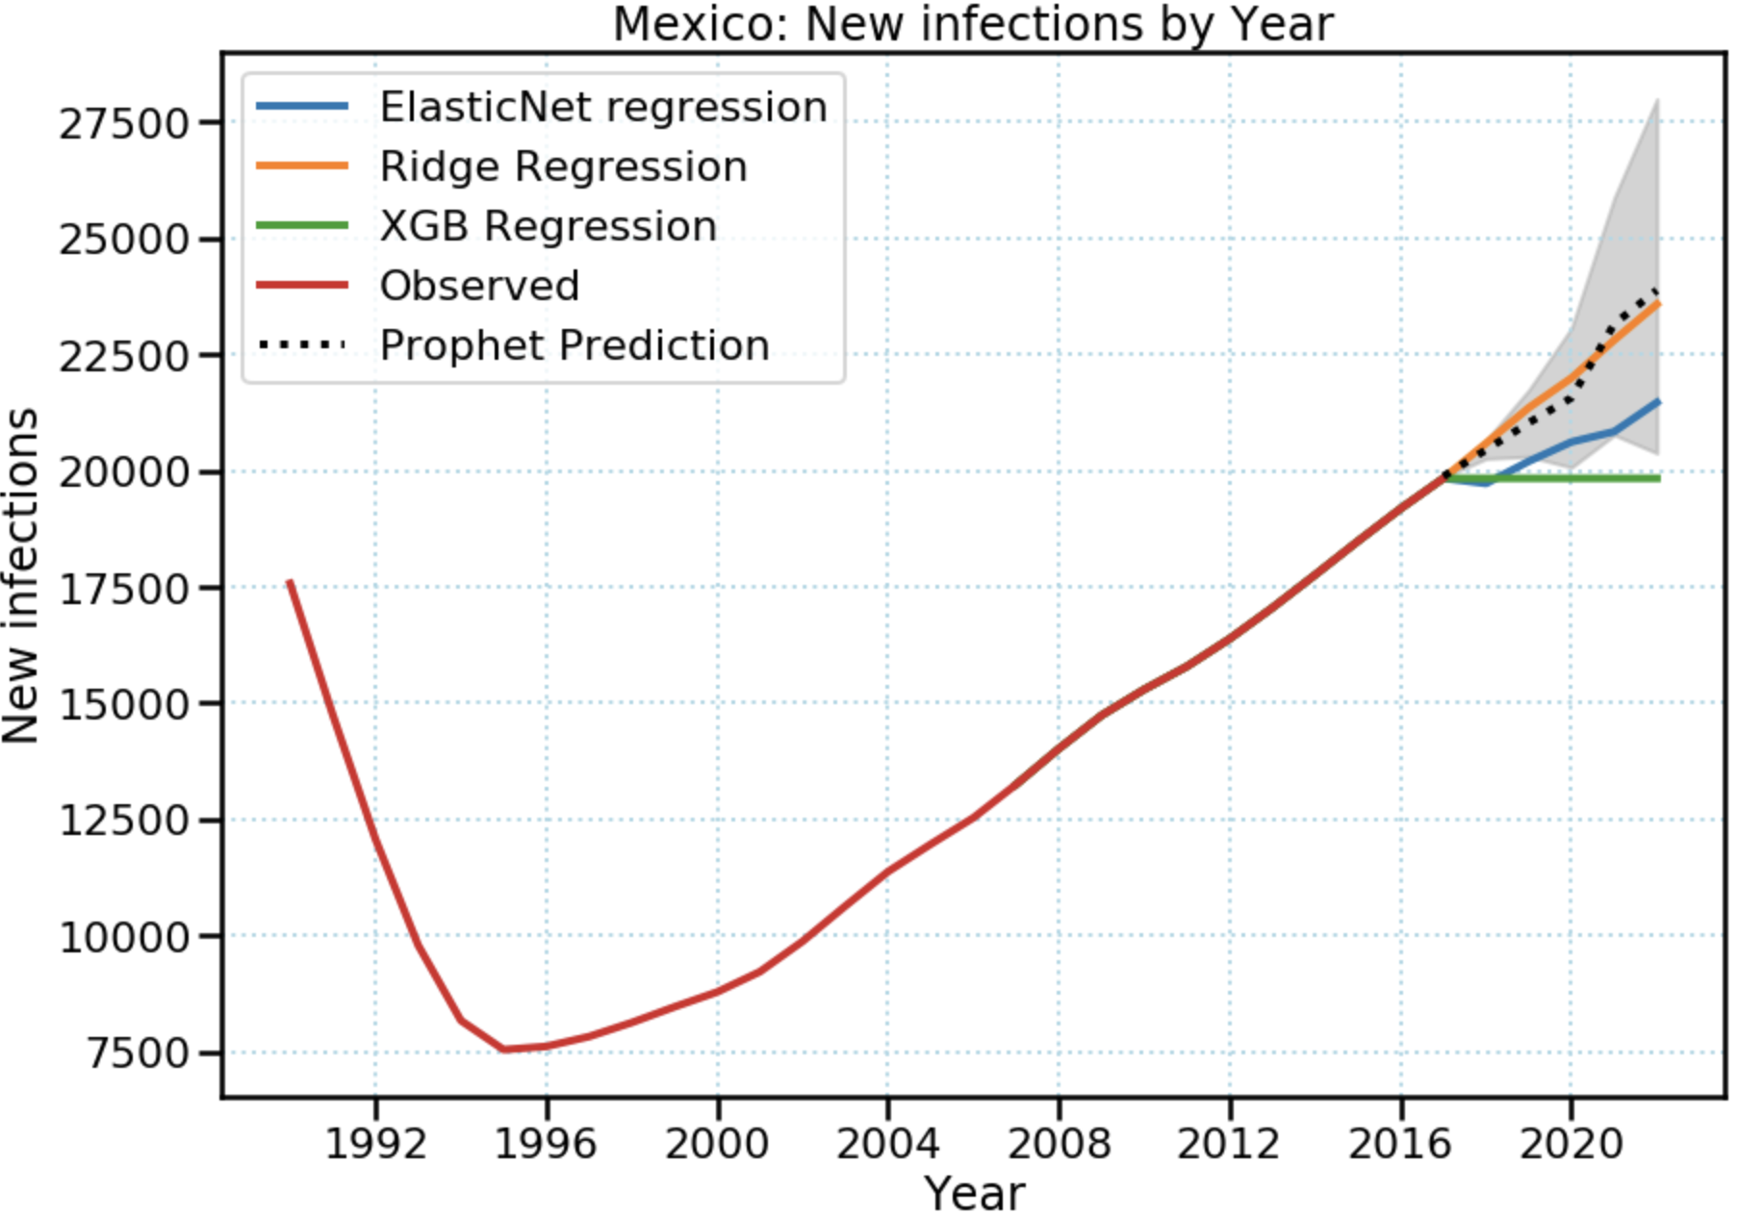
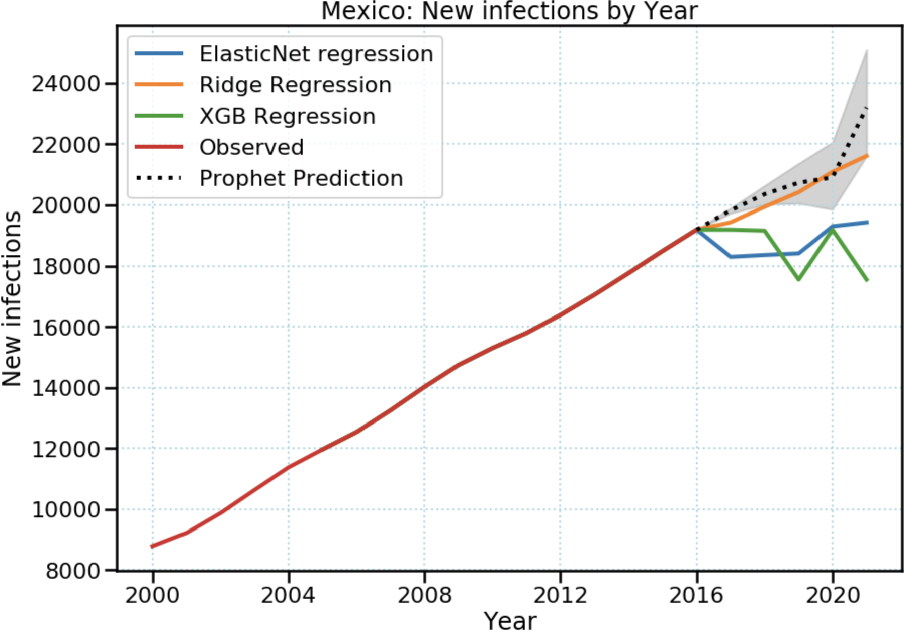
23k
21k

Slide 11








Libraries and Modules
Non-profits

Slide 12
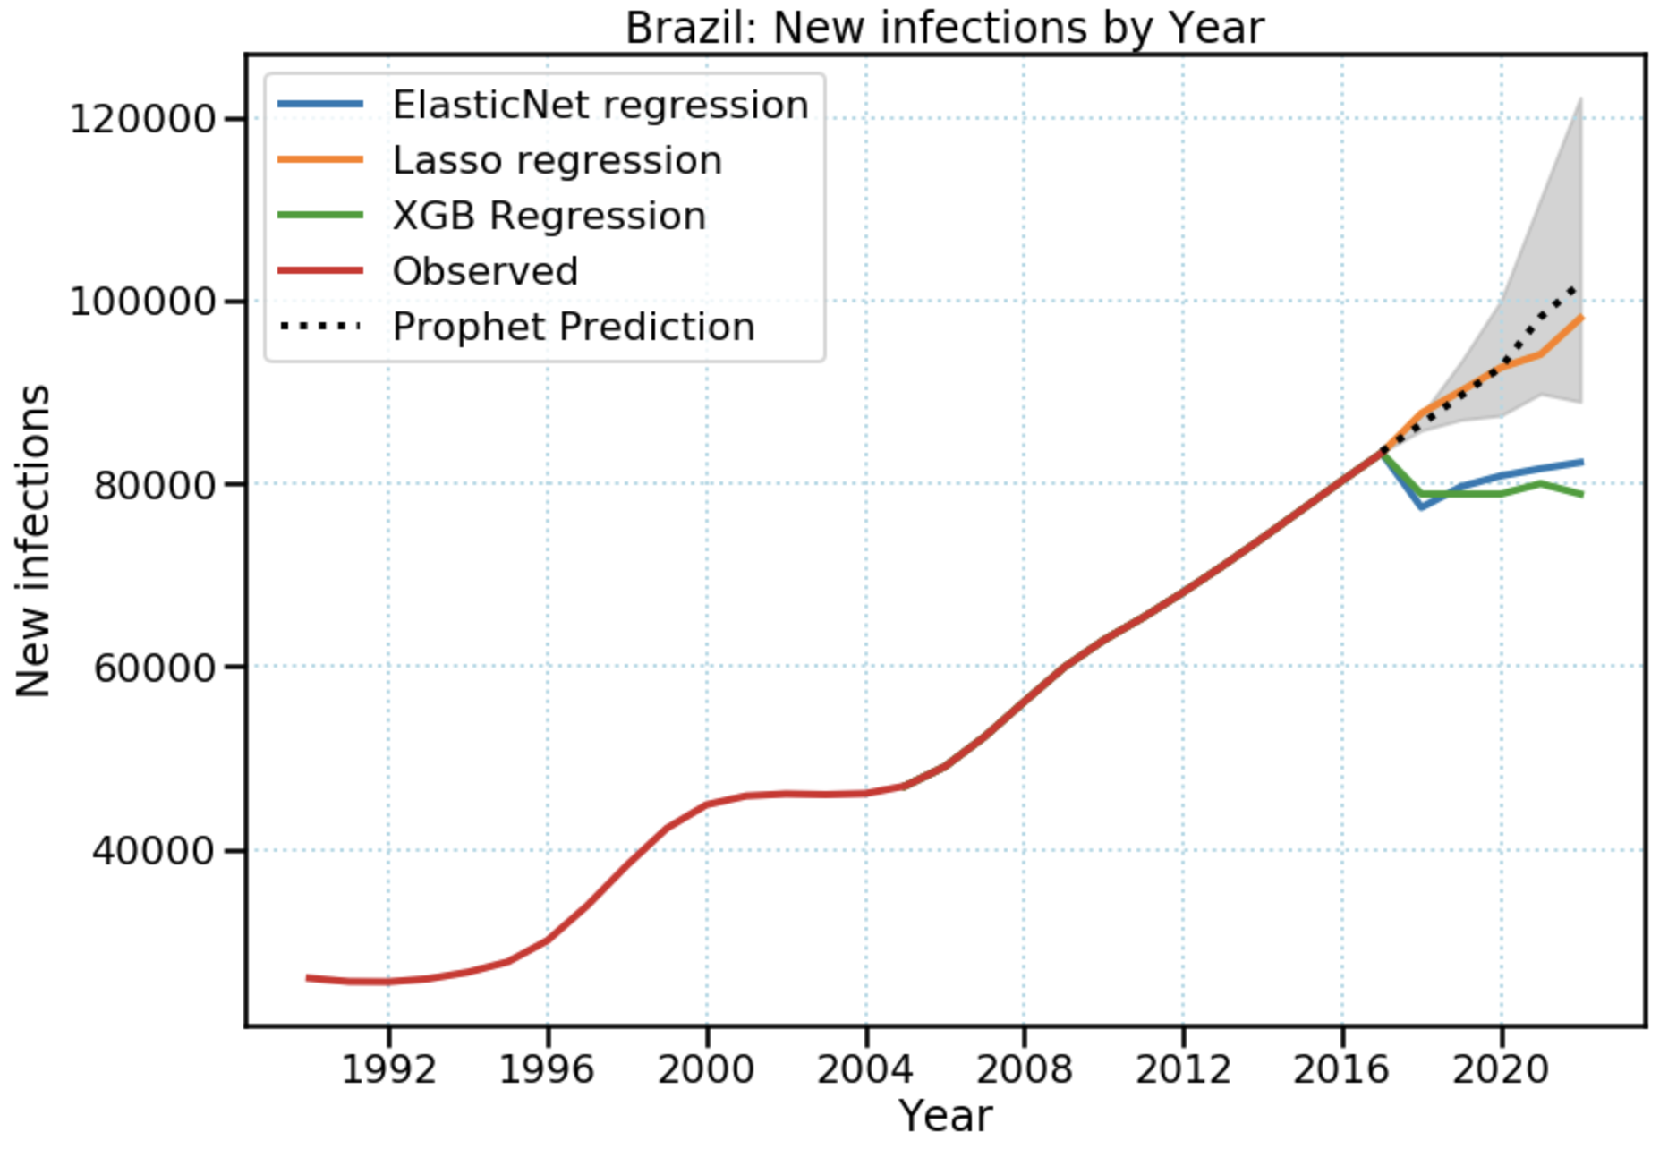
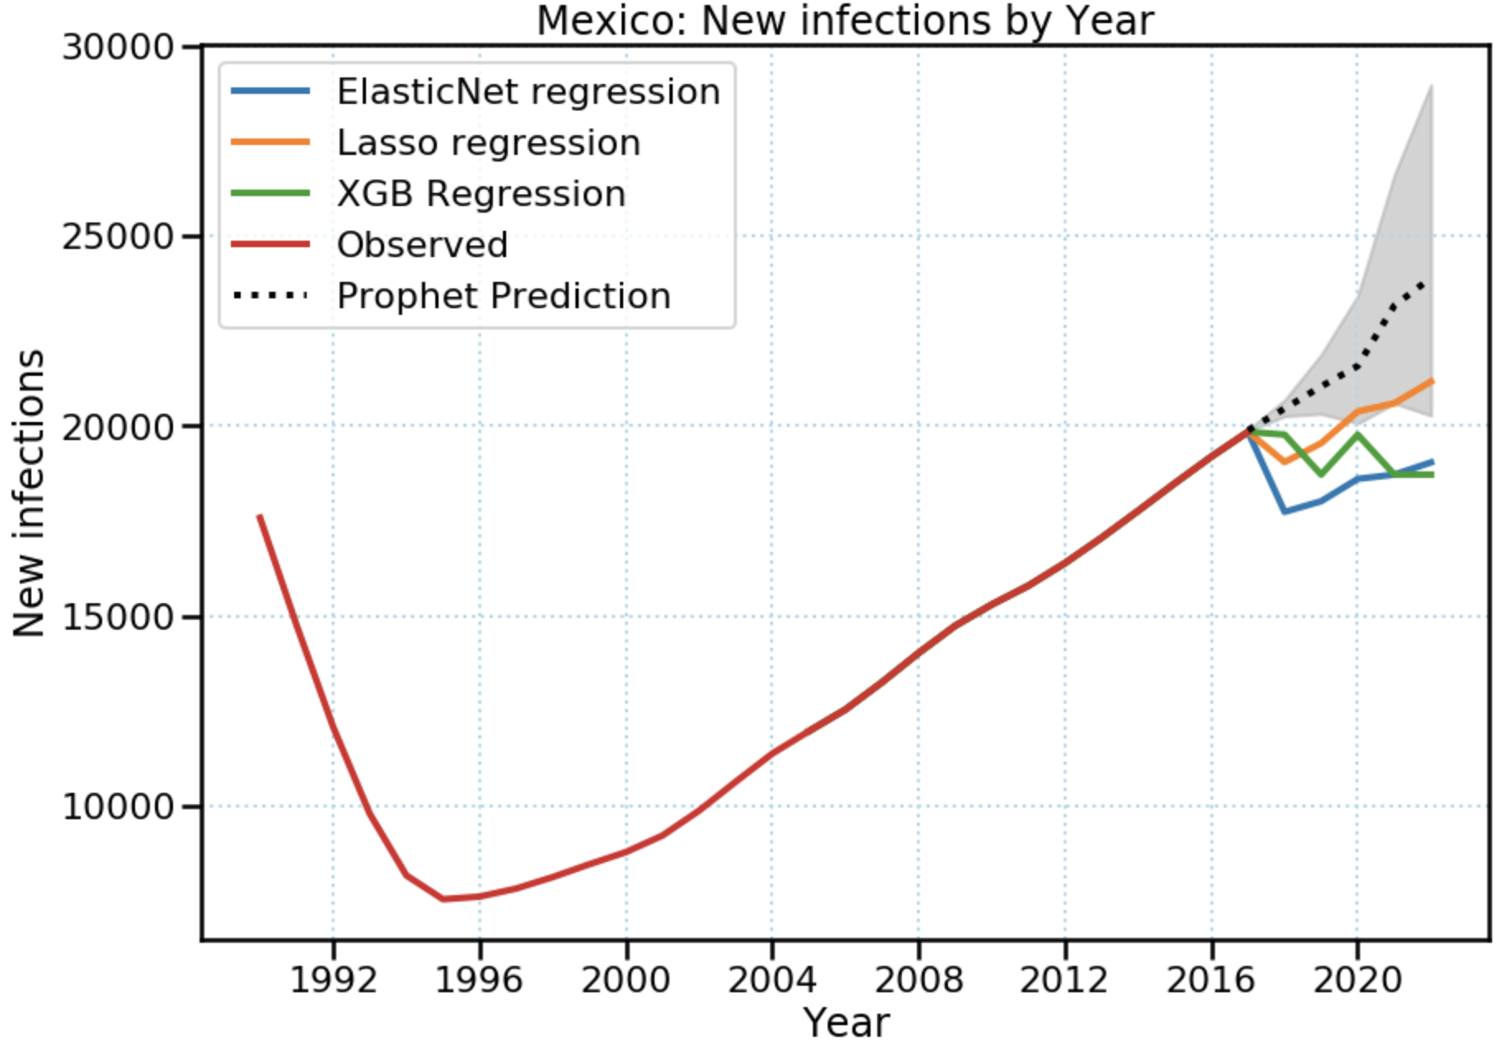
A naive prediction
24k
~93k
20k

Slide 13
Feature Importance
Feature importance is calculated as the decrease in node impurity weighted by the probability of reaching that node. The node probability can be calculated by the number of samples that reach the node, divided by the total number of samples. The higher the value the more important the feature.

